Slide 1
Using webmin for GUI administration of RAID
In preparing the RAID presentation I found an example of configuring Linux RAID using the Browser based application “webmin”.
This is an introduction to webmin.
Waikato Linux User Group
25 Jan 2016
RAID / Webmin Presentation
Ian Stewart

Slide 2
Installing webmin
Note: webmin is not in the ubuntu repositories
$ ls /etc/apt/sources.list.d/ -l
total 0
$ sudo nano /etc/apt/sources.list.d/webmin.list
...enter info...
$ cat /etc/apt/sources.list.d/webmin.list
# Repository for webmin.
deb http://download.webmin.com/download/repository sarge contrib
deb http://webmin.mirror.somersettechsolutions.co.uk/repository sarge contrib

Slide 3
Installing webmin continued...
lsusb
$ sudo wget http://www.webmin.com/jcameron-key.asc
--2016-01-20 13:05:17-- http://www.webmin.com/jcameron-key.asc
Resolving www.webmin.com (www.webmin.com)... 216.34.181.97
Connecting to www.webmin.com (www.webmin.com)|216.34.181.97|:80... connected.
HTTP request sent, awaiting response... 200 OK
Length: 1320 (1.3K) [text/plain]
Saving to: ‘jcameron-key.asc’
jcameron-key.asc 100%[=====================>] 1.29K --.-KB/s in 0.001s
2016-01-20 13:05:17 (1.66 MB/s) - ‘jcameron-key.asc’ saved [1320/1320]
$ sudo apt-key add jcameron-key.asc
OK
#Alternatively. Download from...
#http://www.webmin.com/download.html
#And use Gdebi to install

Slide 4
Installing webmin continued...
lsusb
$ sudo apt-get update
...snipets of webmin messages...
Ign http://download.webmin.com sarge InRelease
Ign http://webmin.mirror.somersettechsolutions.co.uk sarge InRelease
Get:1 http://download.webmin.com sarge Release.gpg [189 B]
Get:2 http://webmin.mirror.somersettechsolutions.co.uk sarge Release.gpg [189 B]
Hit http://download.webmin.com sarge Release
Hit http://webmin.mirror.somersettechsolutions.co.uk sarge Release
Hit http://webmin.mirror.somersettechsolutions.co.uk sarge/contrib amd64 Packages
Hit http://download.webmin.com sarge/contrib amd64 Packages
Hit http://security.ubuntu.com vivid-security/main amd64 Packages
Hit http://webmin.mirror.somersettechsolutions.co.uk sarge/contrib i386 Packages
Ign http://webmin.mirror.somersettechsolutions.co.uk sarge/contrib Translation-en_NZ
Ign http://webmin.mirror.somersettechsolutions.co.uk sarge/contrib Translation-en
Ign http://download.webmin.com sarge/contrib Translation-en_NZ
Ign http://download.webmin.com sarge/contrib Translation-en

Slide 5
Installing webmin continued...
lsusb
$ sudo apt-get install webmin
Reading package lists... Done
Building dependency tree
Reading state information... Done
The following extra packages will be installed:
apt-show-versions libauthen-pam-perl
The following NEW packages will be installed:
apt-show-versions libauthen-pam-perl webmin
0 upgraded, 3 newly installed, 0 to remove and 53 not upgraded.
Need to get 28.0 MB of archives.
After this operation, 156 MB of additional disk space will be used.
Do you want to continue? [Y/n] y
...snip...
Setting up libauthen-pam-perl (0.16-3build1) ...
Setting up apt-show-versions (0.22.7) ...
** initializing cache. This may take a while **
Setting up webmin (1.780) ...
Webmin install complete. You can now login to https://ian-thinkpadx61:10000/
as root with your root password, or as any user who can use sudo
to run commands as root.
Processing triggers for systemd (219-7ubuntu6) ...
Processing triggers for ureadahead (0.100.0-19) ...
$

Slide 6
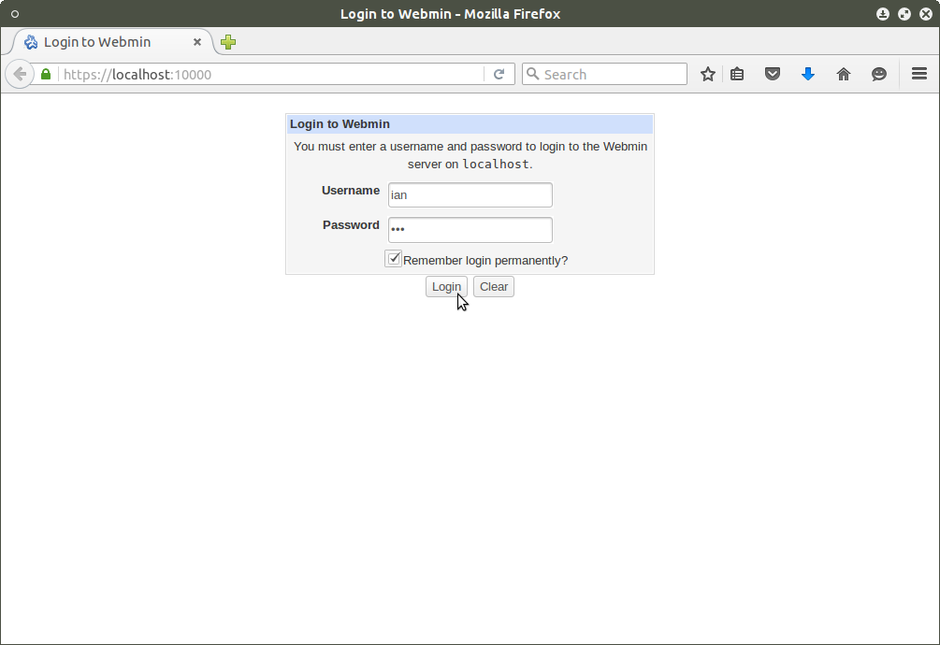
Launch webmin

Slide 7
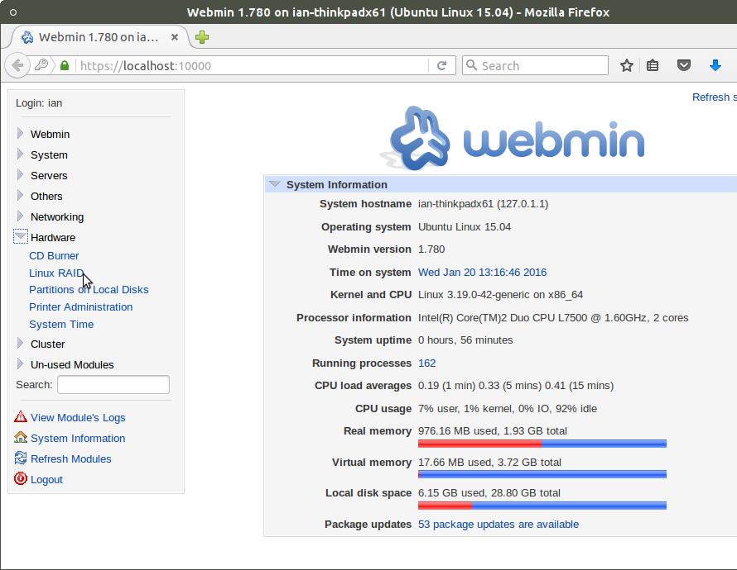
webmin

Slide 8
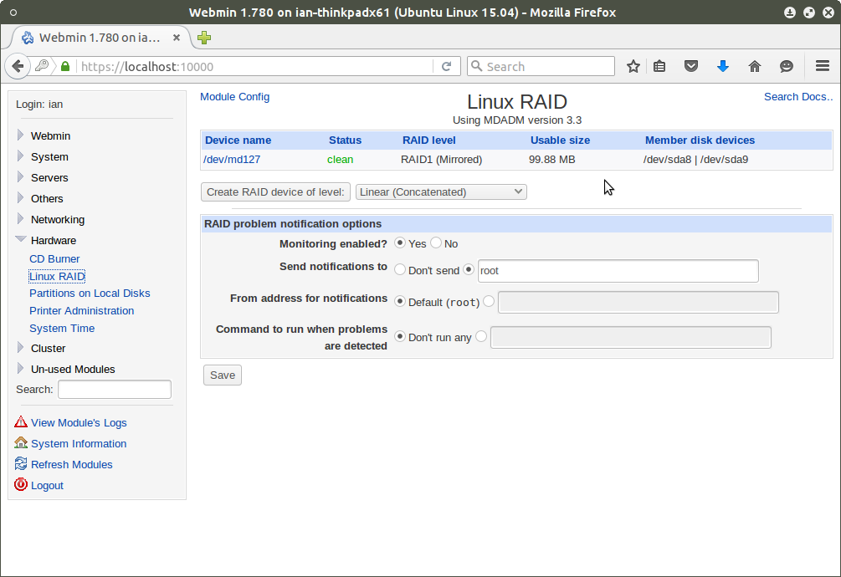
Webmin – Linux RAID

Slide 9
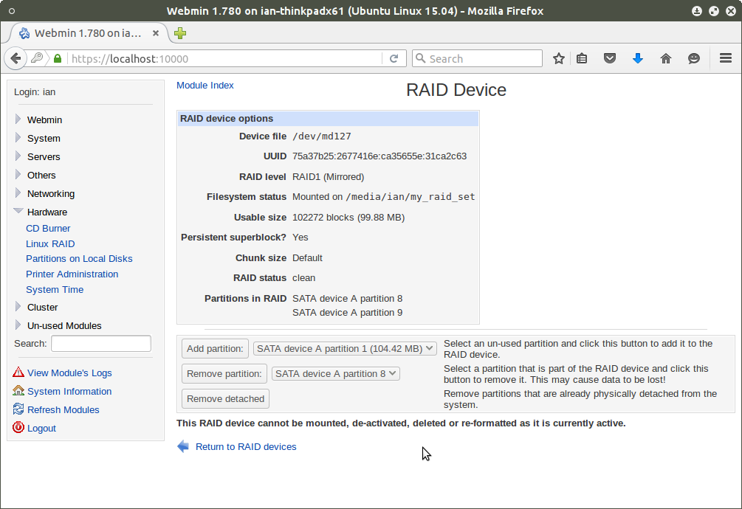
Webmin – Linux RAID

Slide 10
webmin references
http://michal.karzynski.pl/blog/2009/11/18/mdadm-gui-via-webmin/
Youtube: https://www.youtube.com/watch?v=Y4MIWzLwZy8

